Slide 1


Slide 2
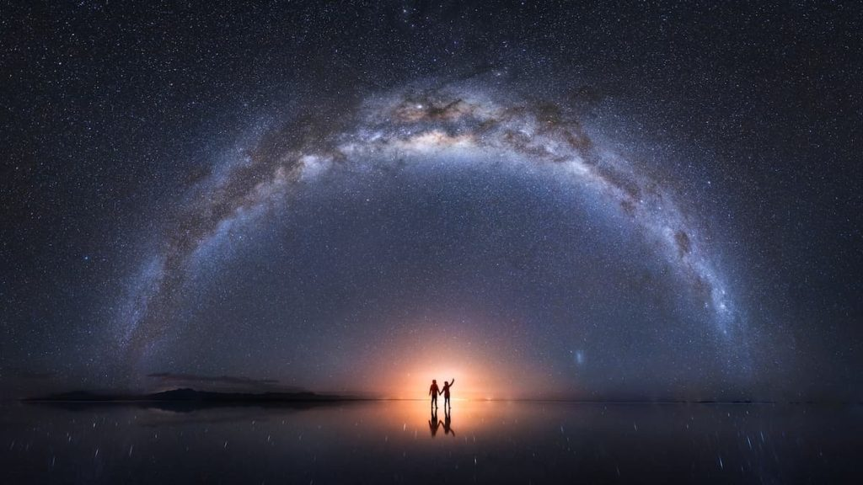
Introduction
Many astonishing photos are not taken in single shot. RHS is taken by famous photographer in Hong Kong – Kelvin Yuen. Per his description, it is composed from 18 pictures
Not easy for others to know how to take it, except having look of those raw photos
Our site provides an all-in-one interface to show both raw and final photo in one screen
Copyright @ Kelvin Yuen

Slide 3
System Overview
Characteristic of PhotoShareShare:
Easy-to-use
Zero administration
Run on open source platform – Free of charge
Suitable for small group photo-sharing use

Slide 4
System Overview
Login / Sign-up
User Profile Management
Album Maintenance
Photo Viewing
Photo Owner
Photo Viewer
Like Photo Response

Slide 5
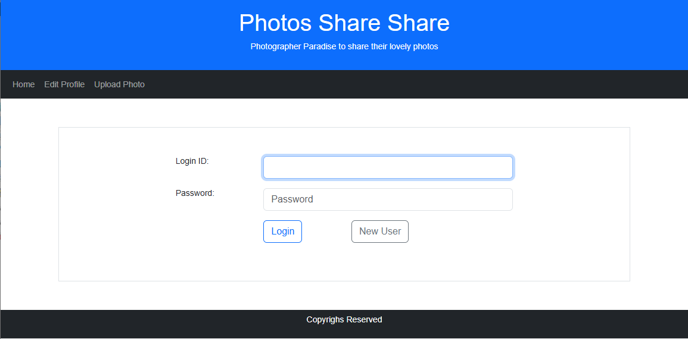
System Log-in

Slide 6
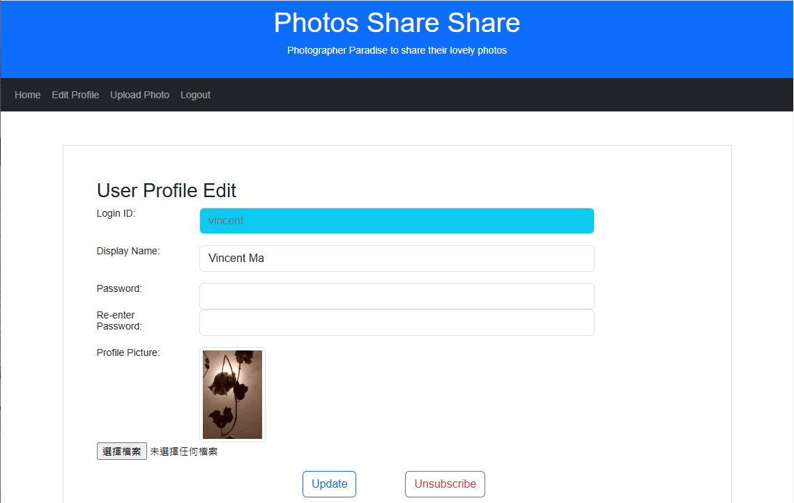
User Profile Edit

Slide 7
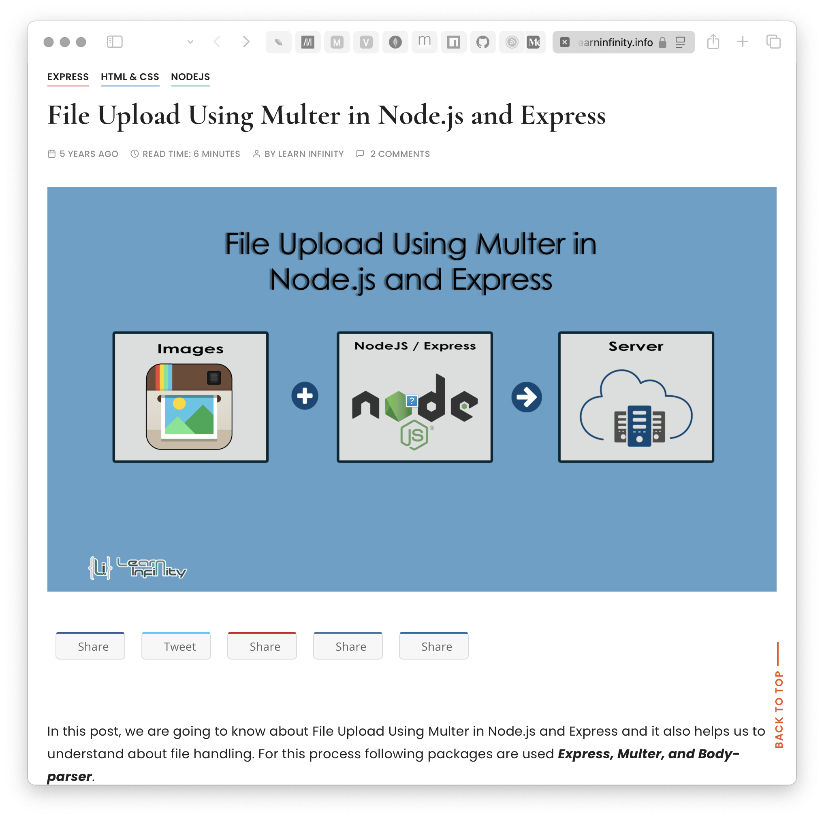
upload files with multer in express

Slide 8
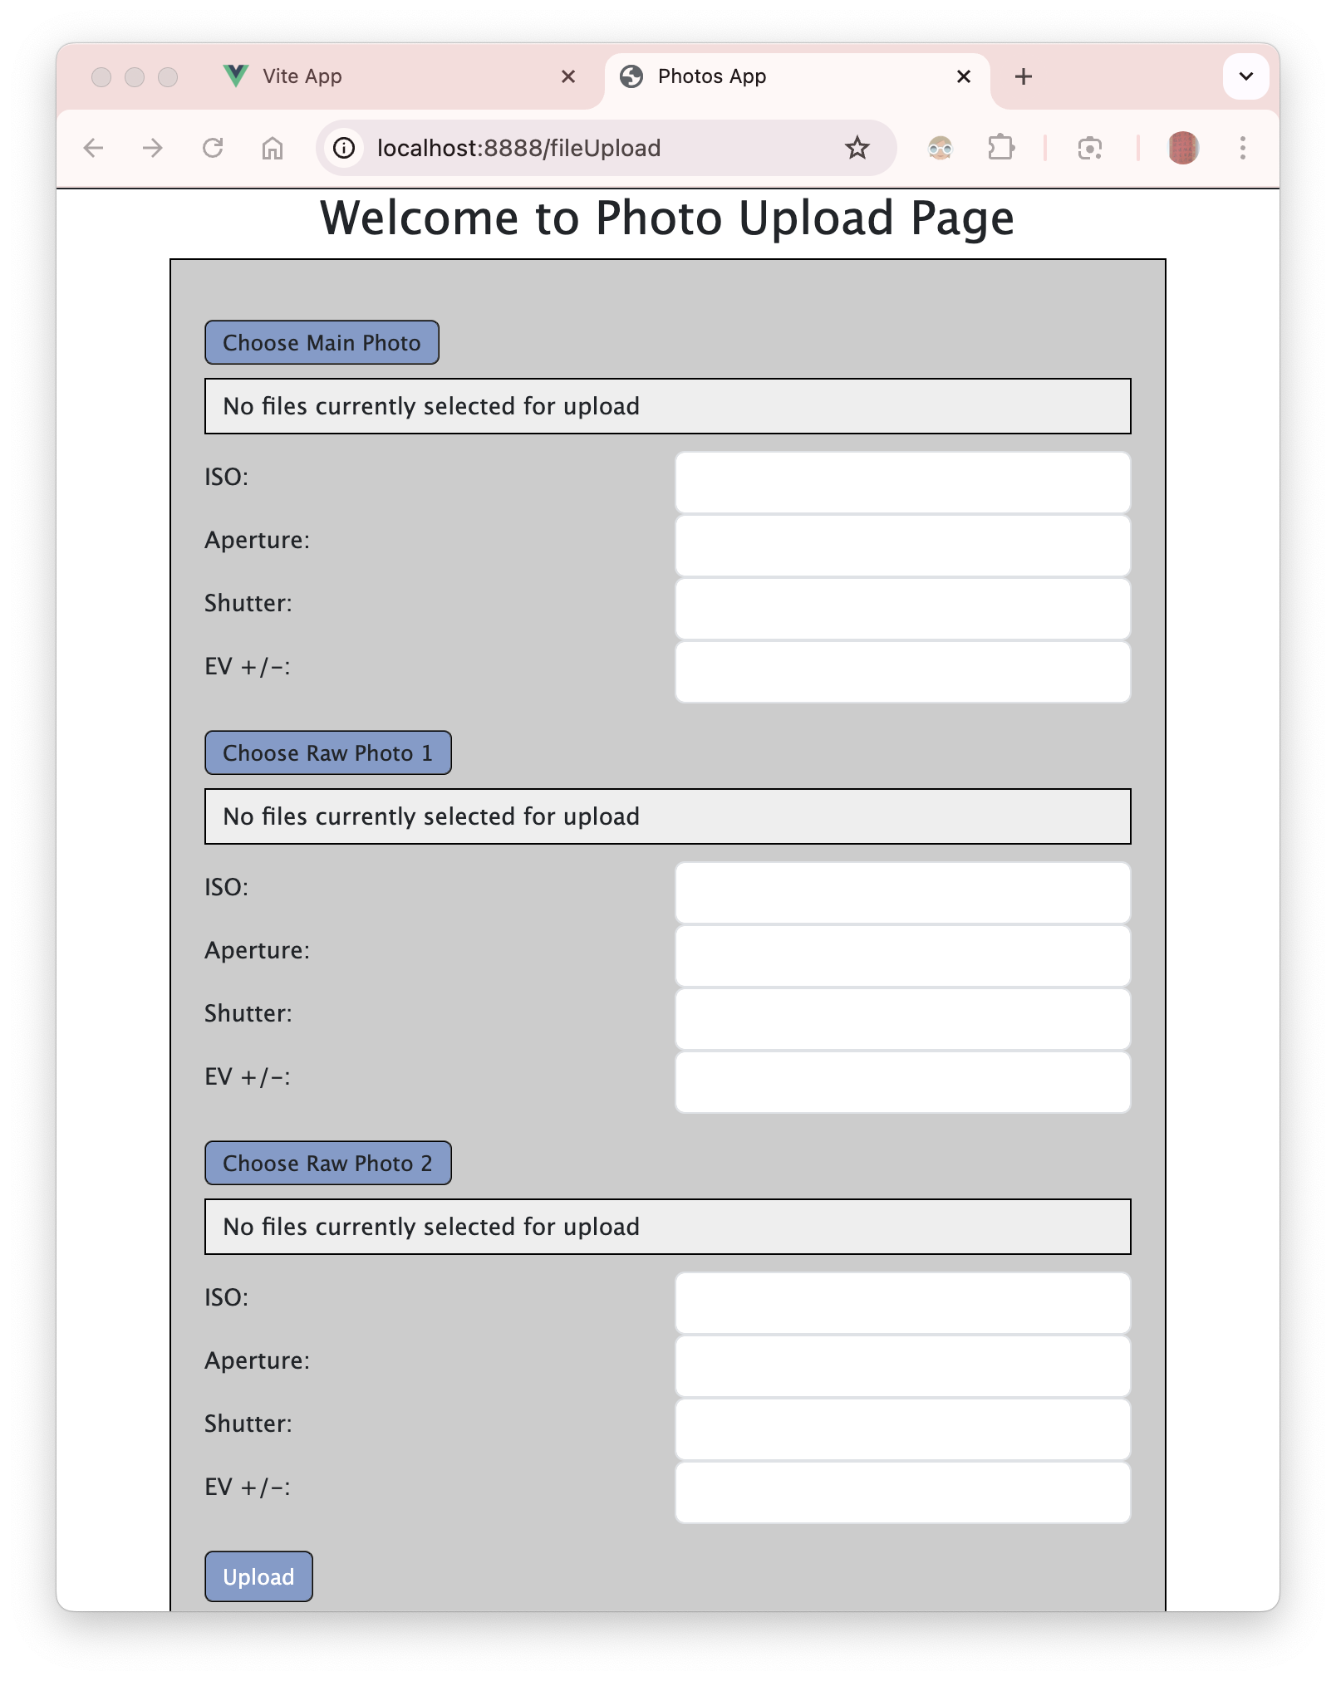
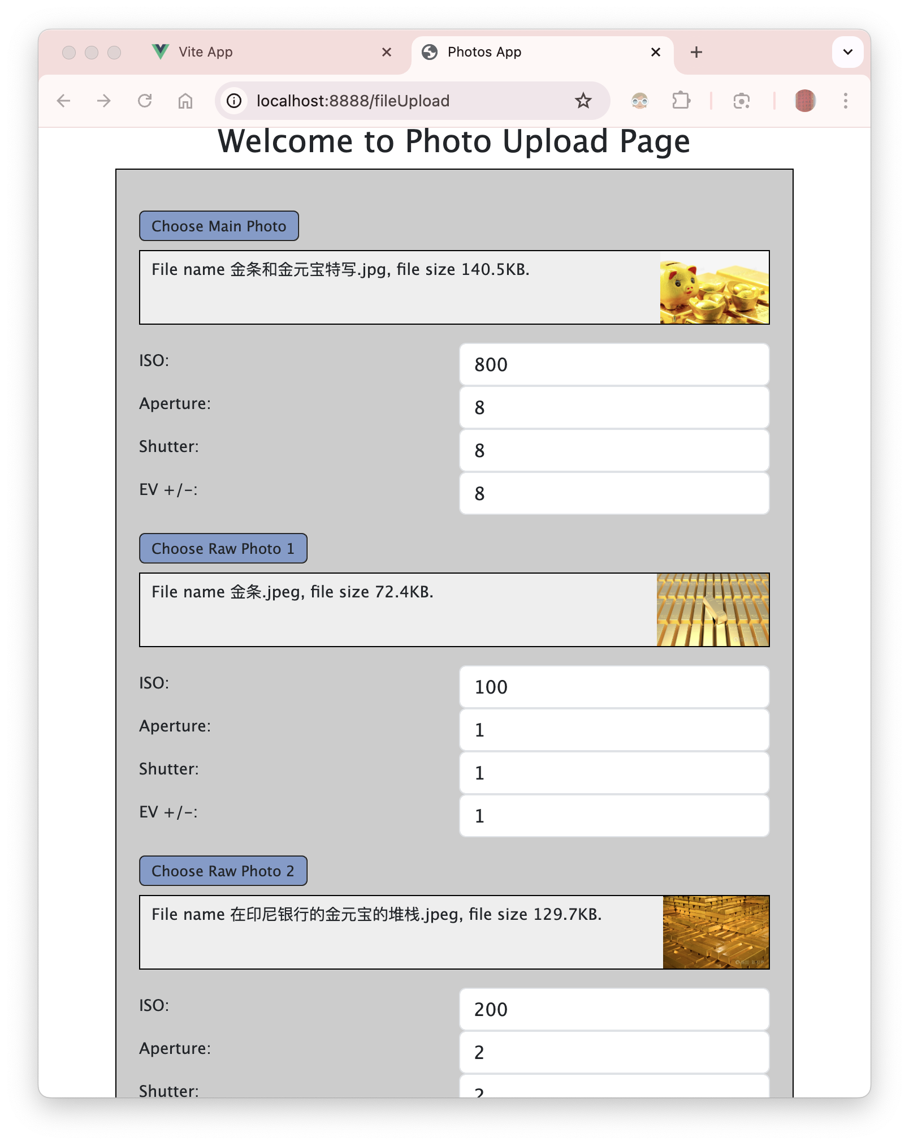

Slide 9
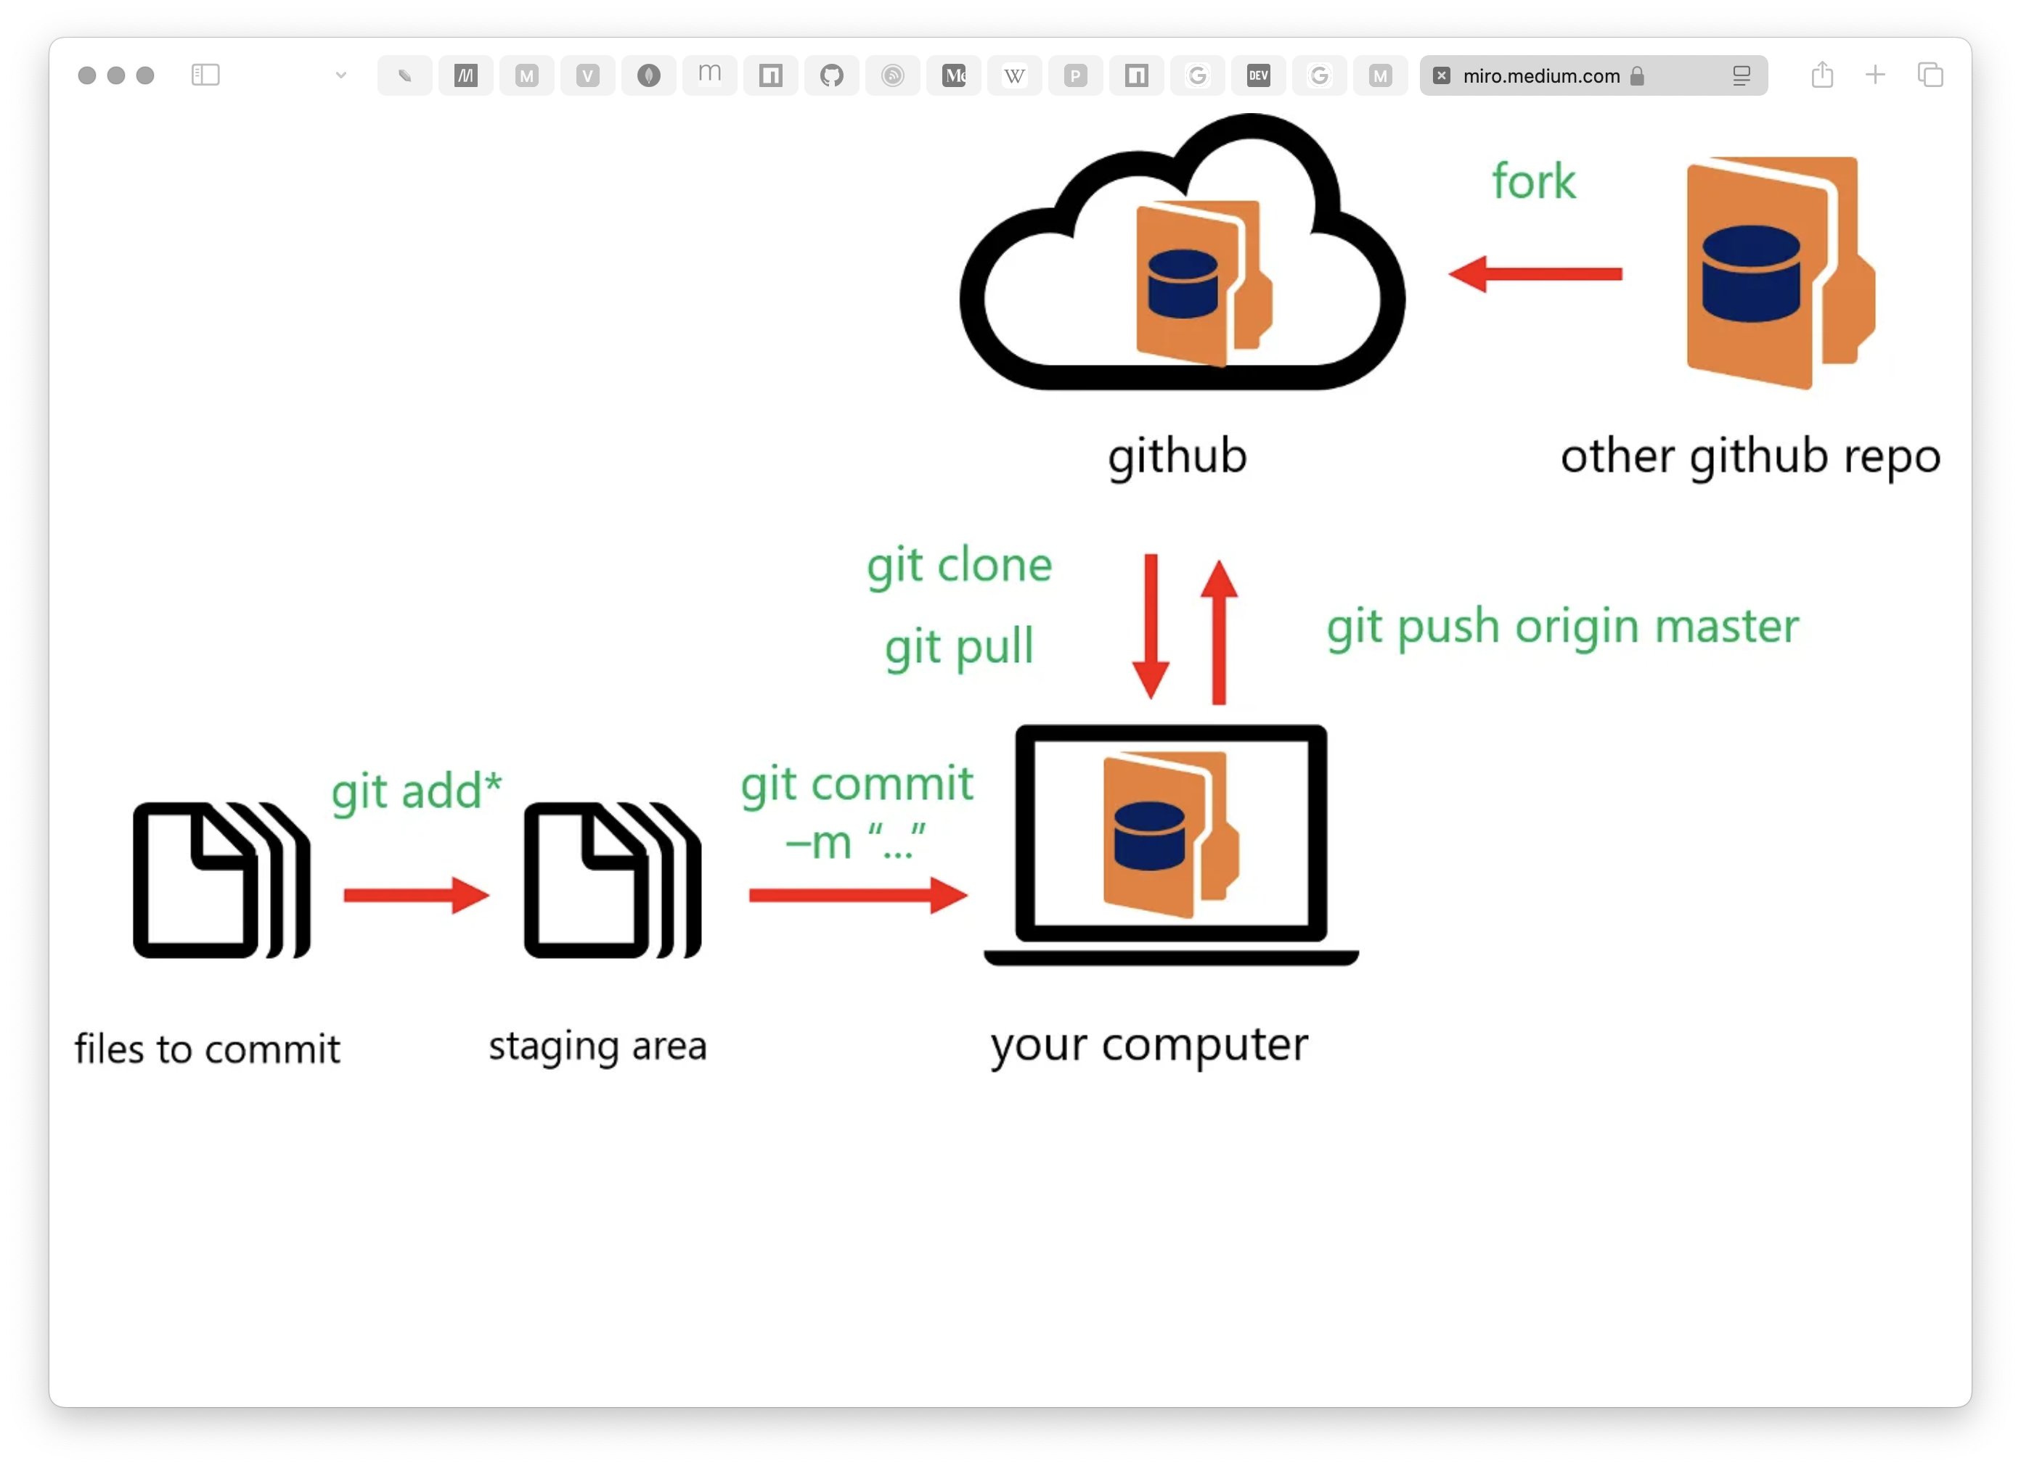
Git and GitHub

Slide 10
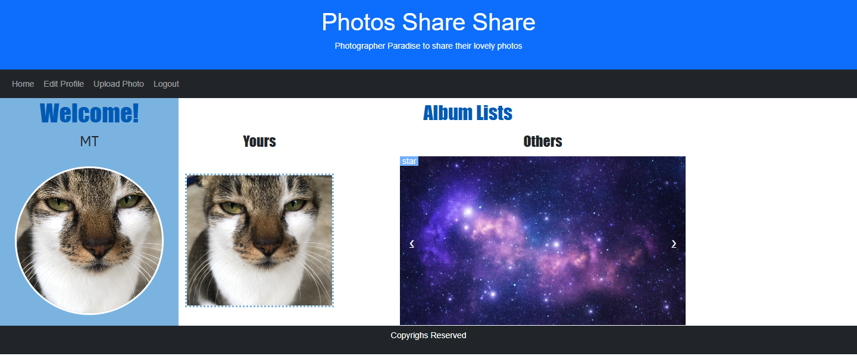
Album List
Layout Style
Easy-to-read
Energy
Layering
Colours
Font size and style
Parts
Left and right

Slide 11
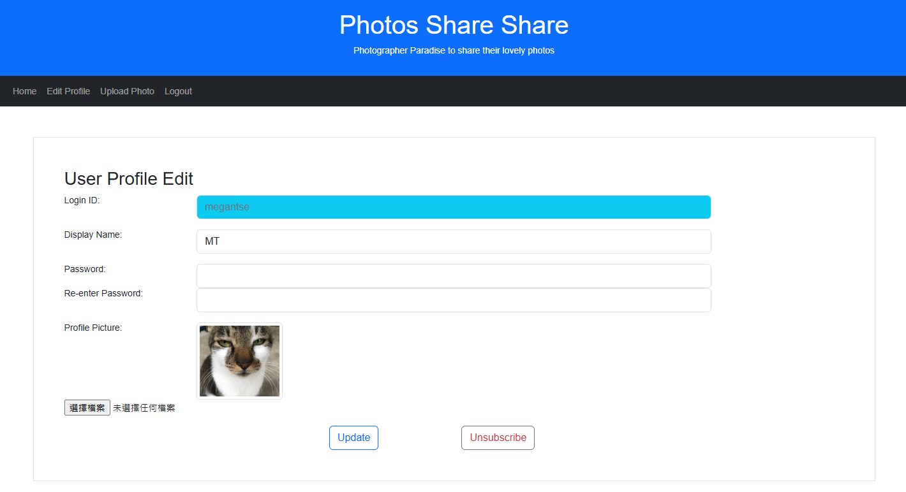
Album List
Left-hand side
“Welcome!”
User’s profile
Display name
Profile picture
Profile Pic
White border
Circle-shaped
Hyperlink
User profile edit

Slide 12
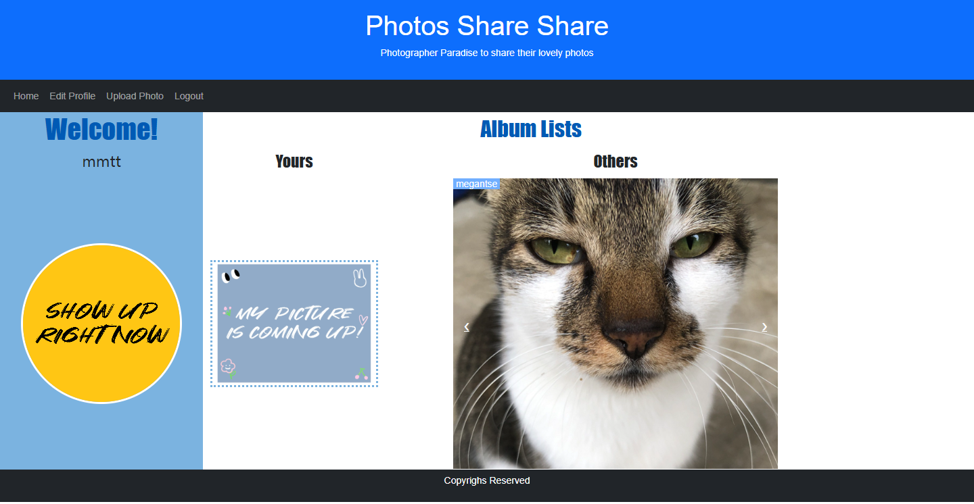
Album List
Right-hand side
Yours
Logged-in user’s album
Profile picture
Dotted border
Others
Other users’ albums
Profile picture
Go & back by hands
Yours / Others
Links to photo list

Slide 13
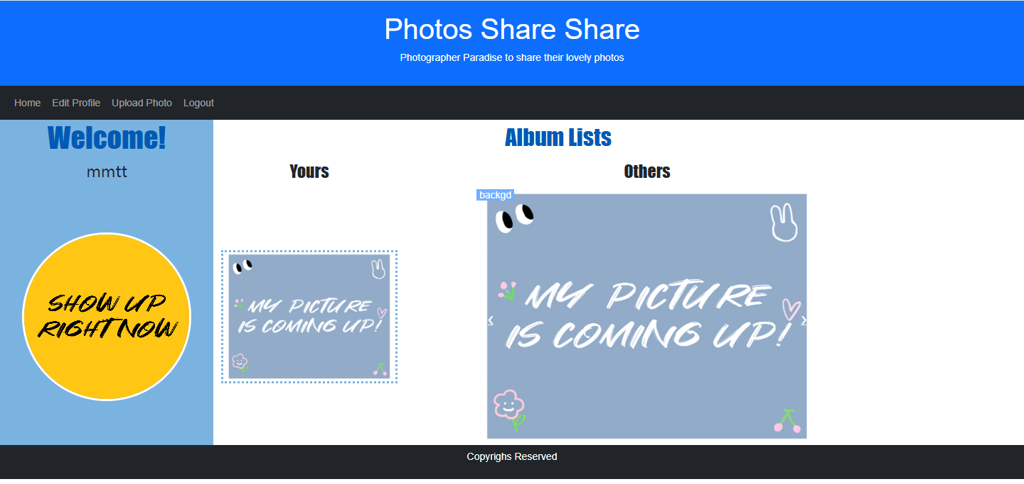
Album List
Both sides
Default images if no photo uploaded

Slide 14
PHOTOLIST
page showing the photos uploaded by all registered users

Slide 15
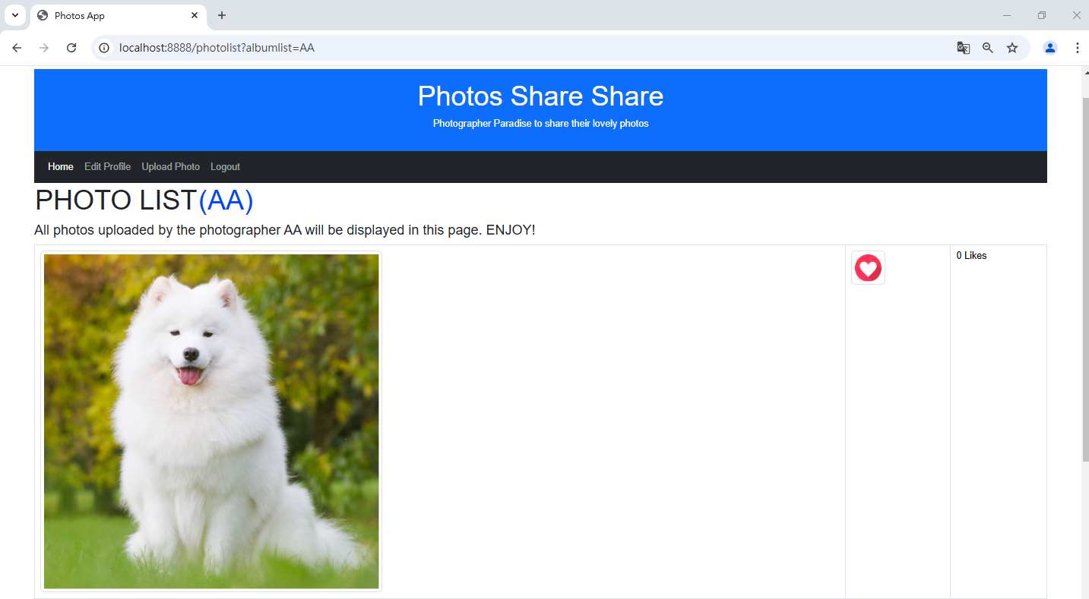
Like/ Unlike Function

Slide 16

Like/ Unlike Function

Slide 17
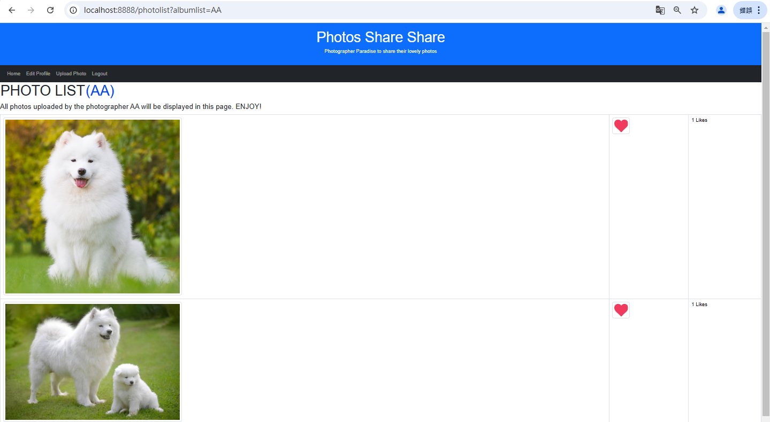
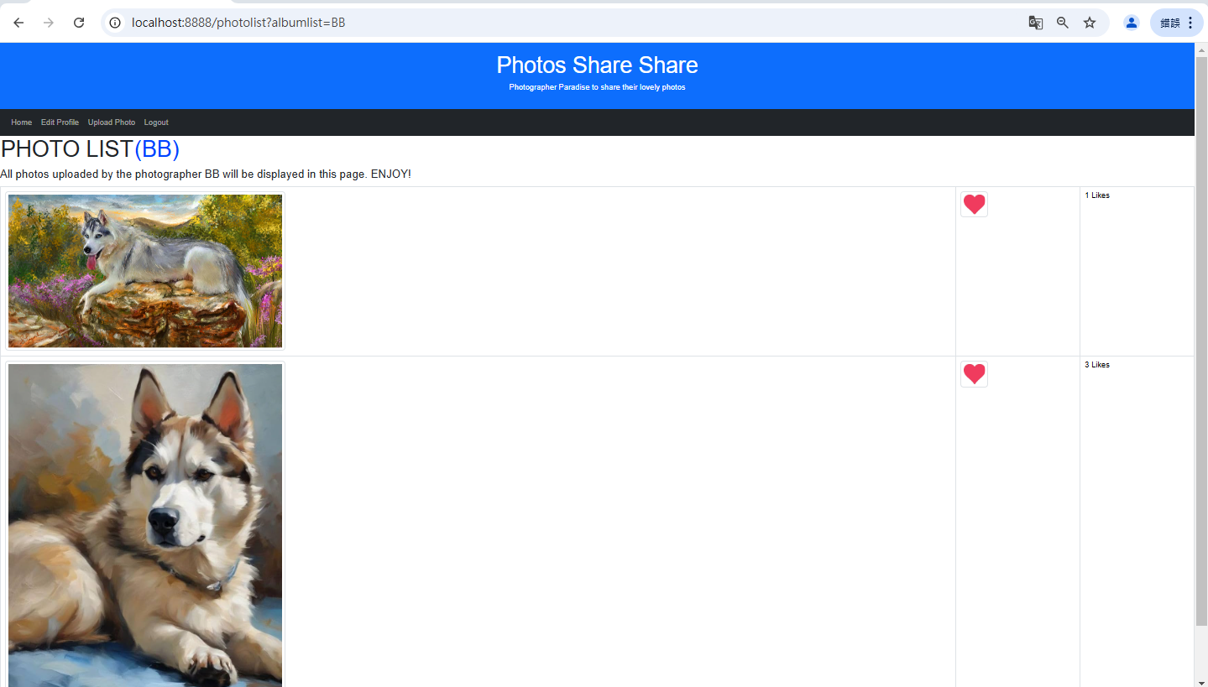

Slide 18
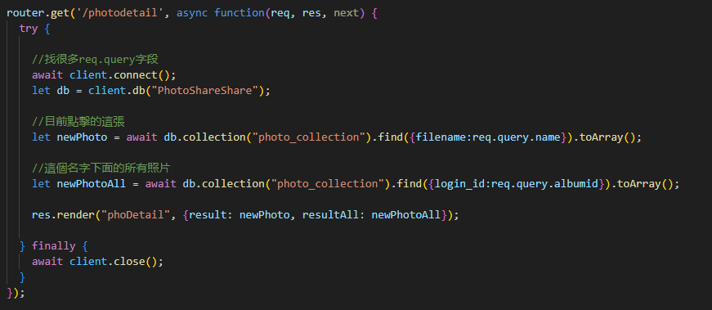
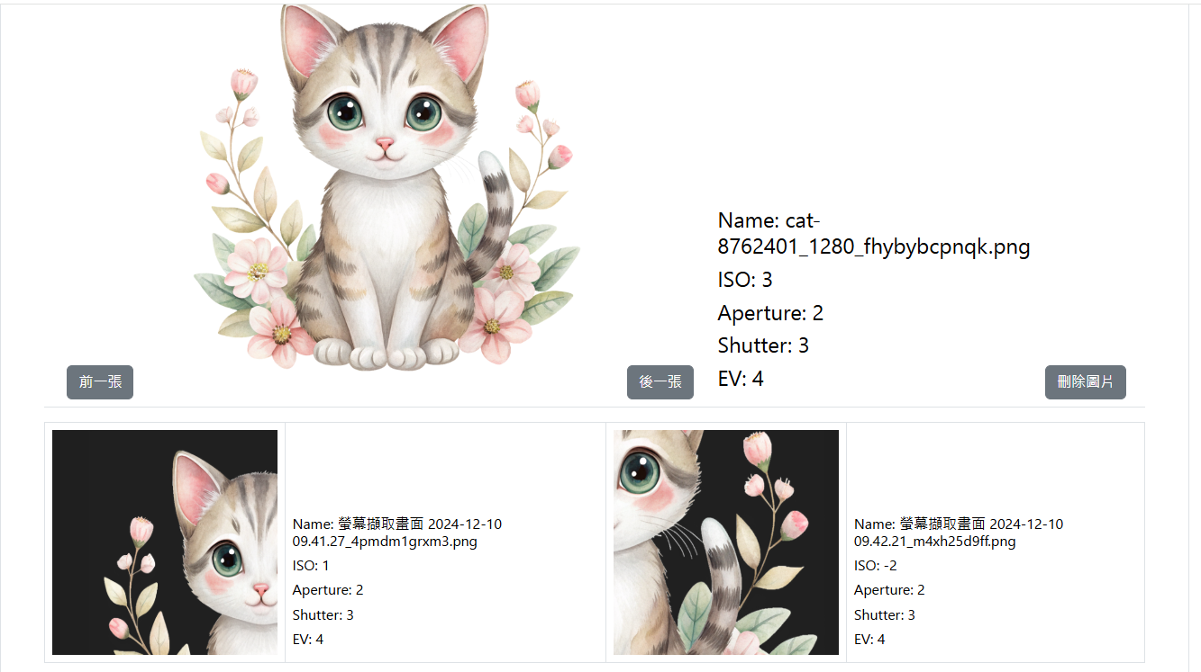
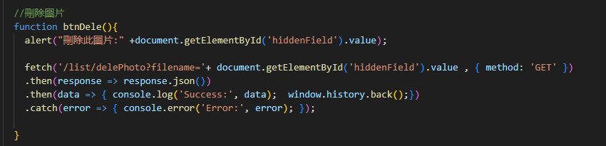
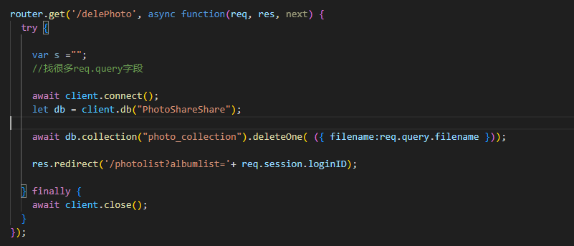
Photo Detail
01
02
03

